Slide 1
Analyzing Data Using Clustering Methods
Tyler Borgard

Slide 2
Objectives
We want to be able to identify certain populations of cells that have similar characteristics
For two dimensional data, eyeballing it is usually sufficient
However, for higher dimensions (>3), it’s necessary to use unsupervised clustering methods

Slide 3
Possible Approaches
We could use dimensionality reduction for easier visualization
There are also several clustering methods we could use for data of arbitrarily many dimensions
We will be analyzing Kmeans and Gaussian Mixture

Slide 4
Kmeans
Kmeans splits the data into clusters, each of which is assigned a centroid
The centroid of a cluster is the mean of all the points in the cluster
Each point in the dataset is assigned to the cluster with the closest centroid
“close” defined by Euclidean distance

Slide 5
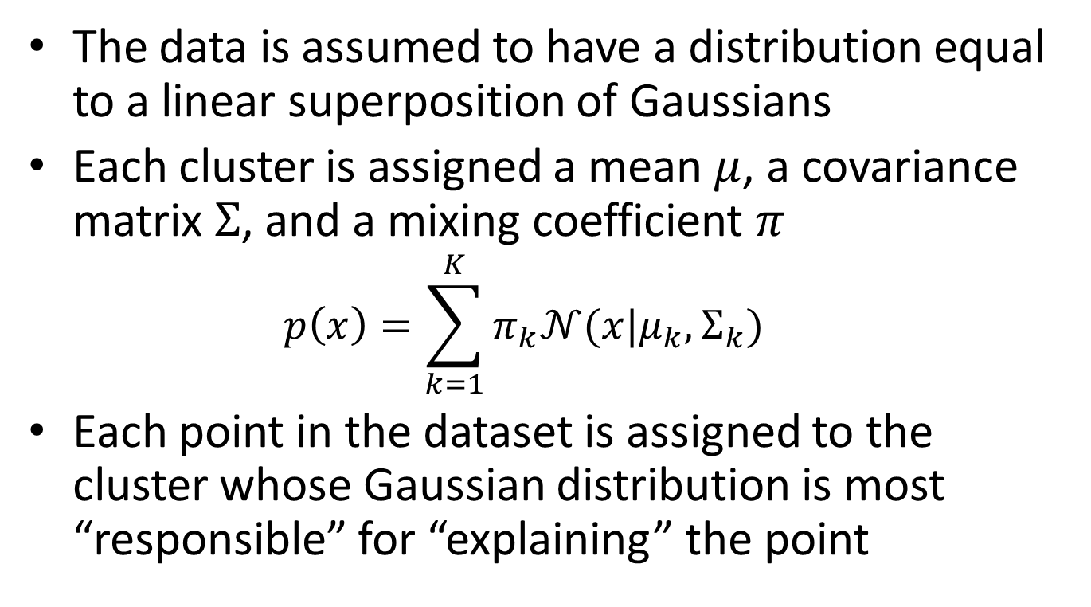
Gaussian Mixture
The data is assumed to have a distribution equal to a linear superposition of Gaussians
Each cluster is assigned a mean $μ$, a covariance matrix $Σ$, and a mixing coefficient $π$
$$p\left(x\right)=\sum_{k=1}^{K}{π_{k}𝒩(x|μ_{k},Σ_{k})}$$
Each point in the dataset is assigned to the cluster whose Gaussian distribution is most “responsible” for “explaining” the point

Slide 6
About the data
There are 10 datasets (K1-K5, W1-W5)
Each dataset includes 7 parameters, so each cell is effectively a point in 7D space
To display the data, we plot every possible pair of axes against each other
The result is a 7x7 grid of plots
The clustering still takes into account all the dimensions, not just the two plotted

Slide 7
Restrictions Made to Datasets
Only included points where:
PI < 10000
High PI means the cell is dead
CD45 PE > 10000
High CD45 PE means the cell is a white blood cell

Slide 8
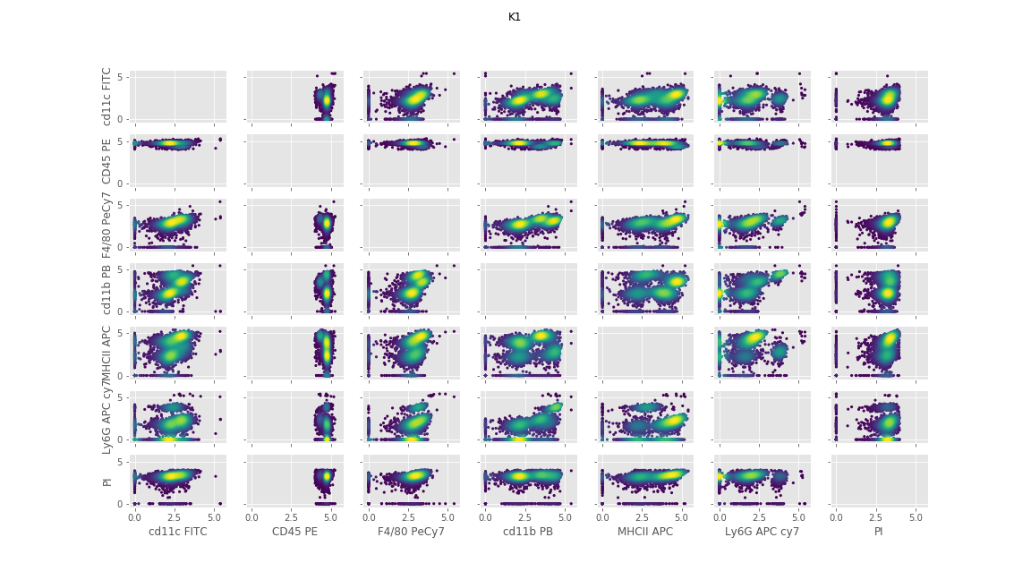
K1 Density Plot

Slide 9
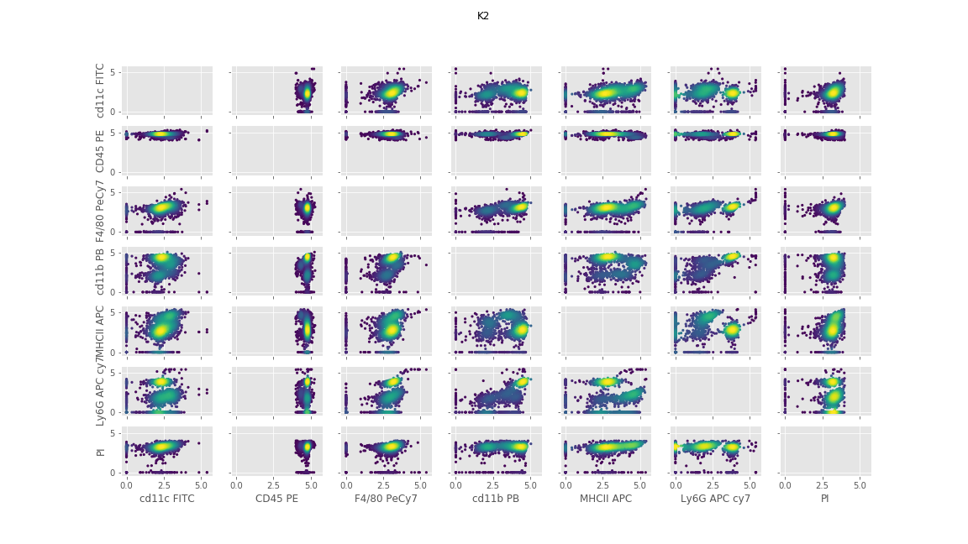
K2 Density Plot

Slide 10
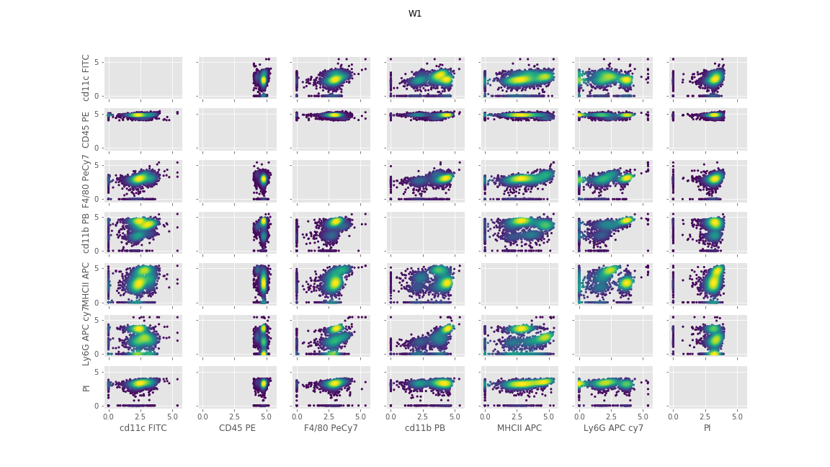
W1 Density Plot

Slide 11

W2 Density Plot

Slide 12
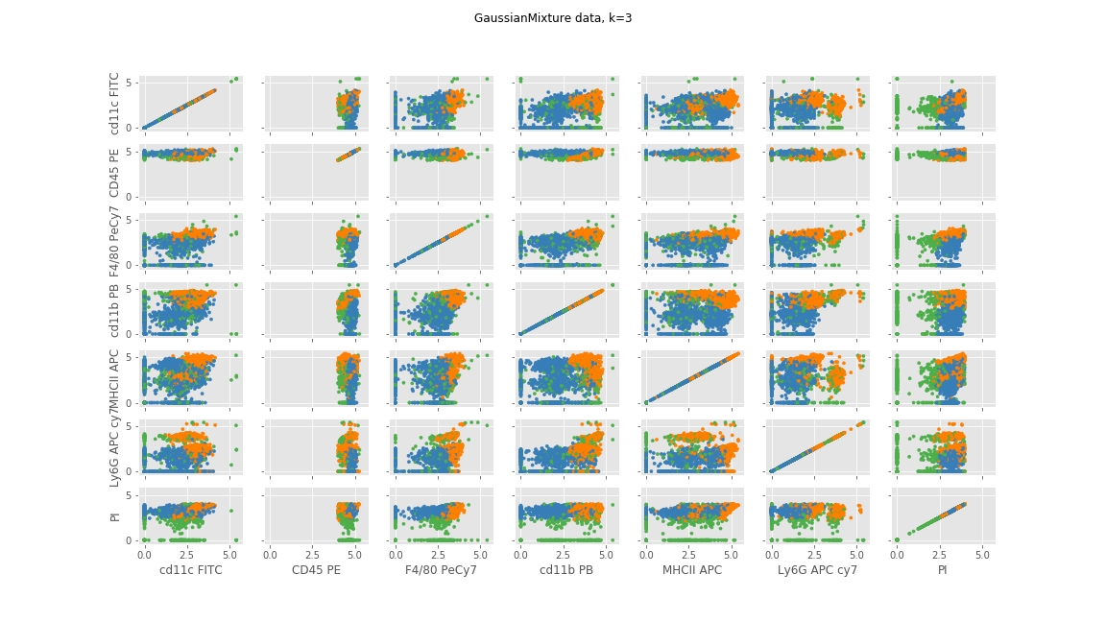
Example Clustering (K1)

Slide 13
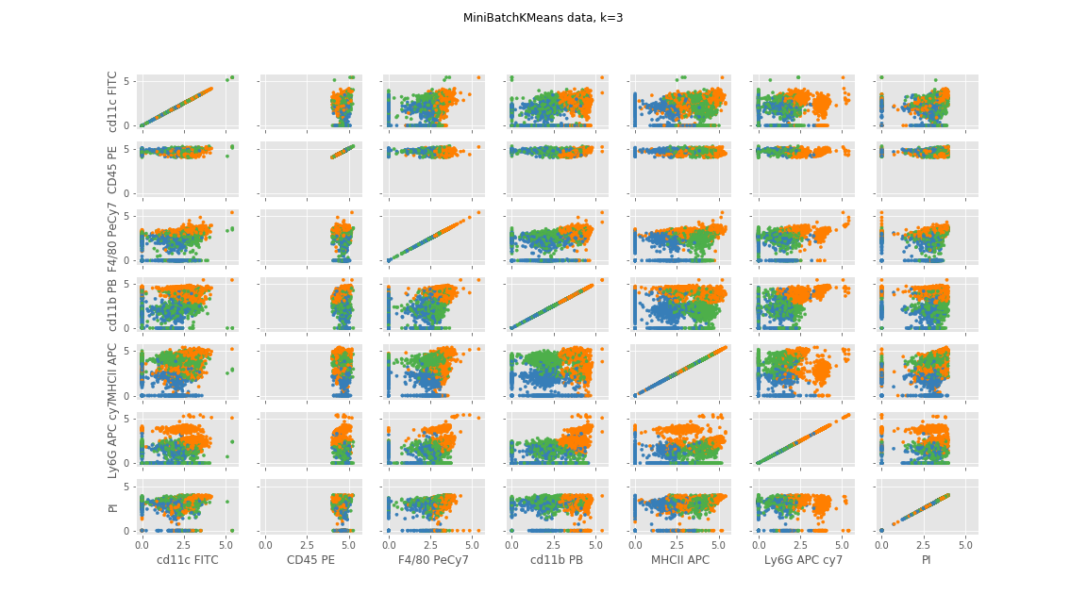
Example Clustering (K1)

Slide 14
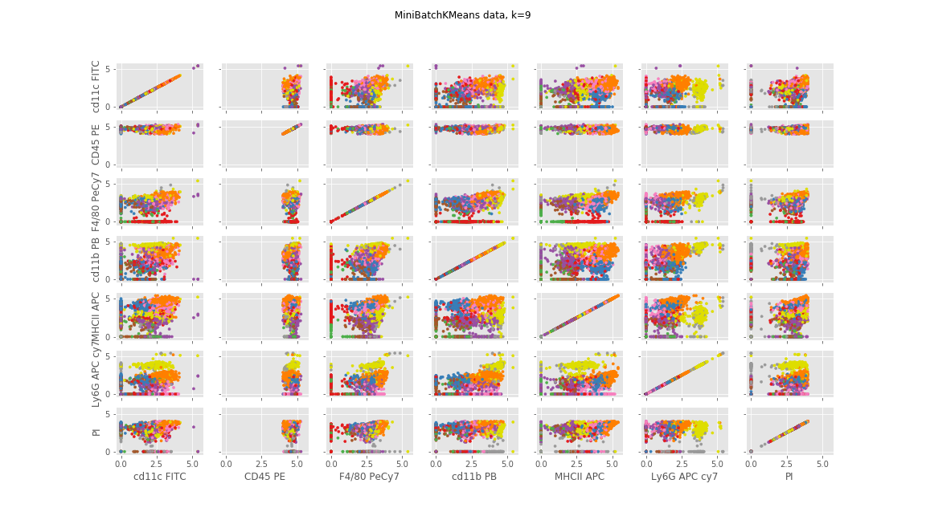
Example Clustering (K1)

Slide 15
Evaluating the Plots
One way to test a clustering method is to see if it identifies a known population
Neutrophils have high values of Ly6G APC cy7
Gaussian Mixture with 3 clusters:
Split neutrophils into two clusters, one of which includes a lot of other cells too
Kmeans
3 clusters: combined neutrophils and other cells into one cluster
9 clusters: identifies neutrophils pretty well

Slide 16
Consistency
Unfortunately, these clustering methods aren’t perfectly consistent, as the next two plots will show

Slide 17
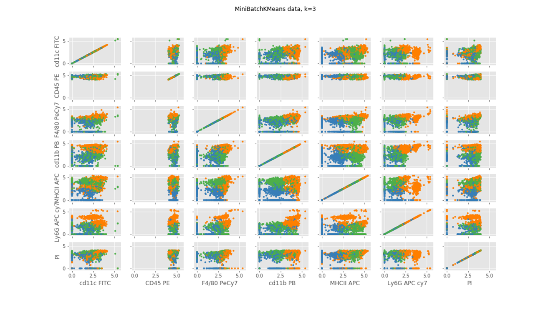
K1 trial 1 (same plot from earlier)

Slide 18
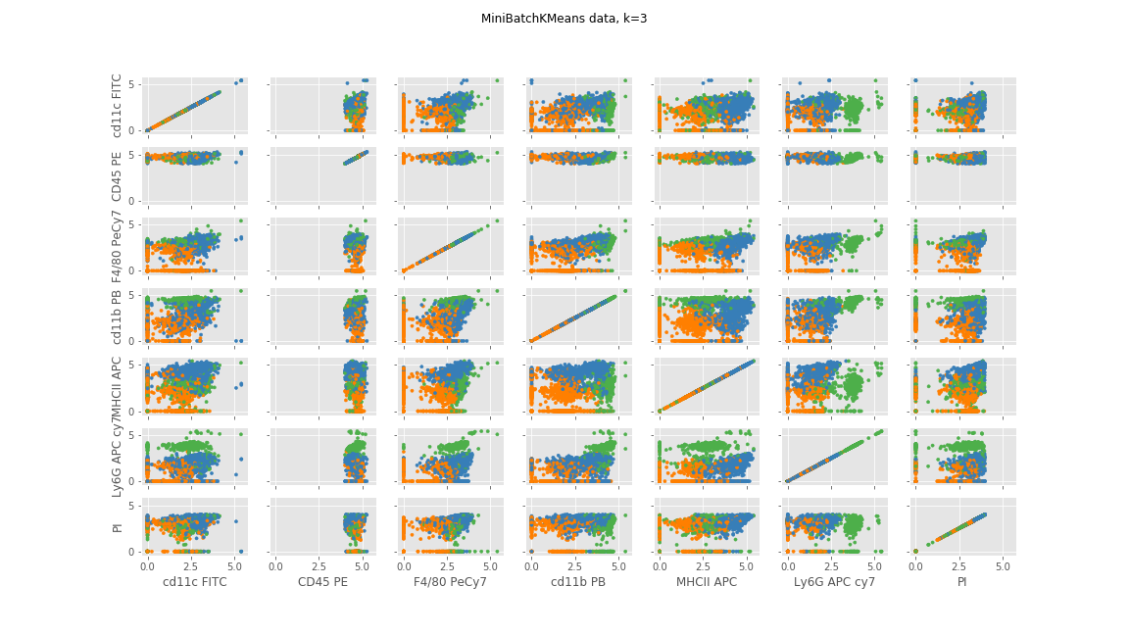
K1 trial 2

Slide 19
Comparing the trials
Trial 2 is way better at identifying the neutrophils
Important question: how consistent are the clustering methods?
We can test this by running 100 trials and plotting all the centroids together
The fewer points we see, the more consistent the clustering method is
If the points are very spread out, that’s a bad sign

Slide 20
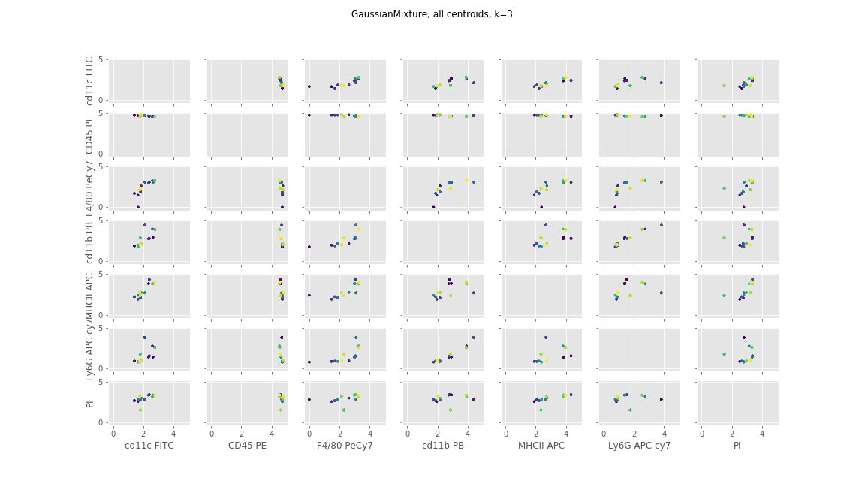
Centroid Plot (K1)

Slide 21
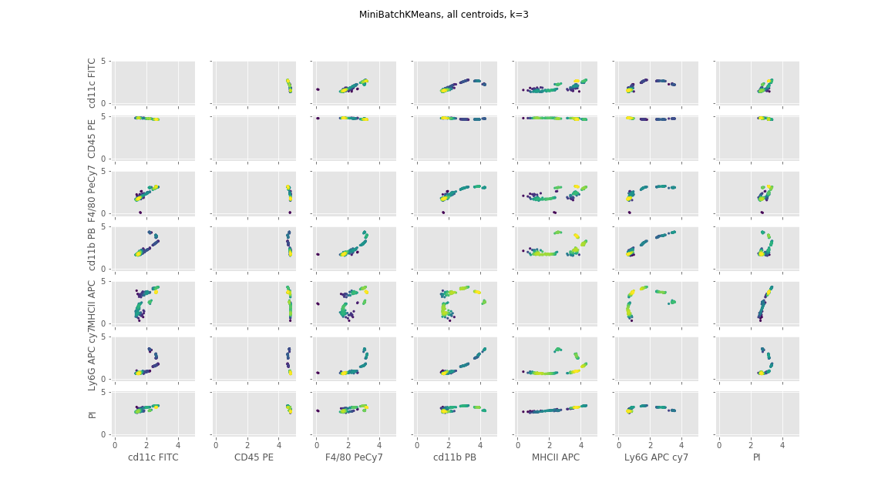
Centroid Plot (K1)

Slide 22
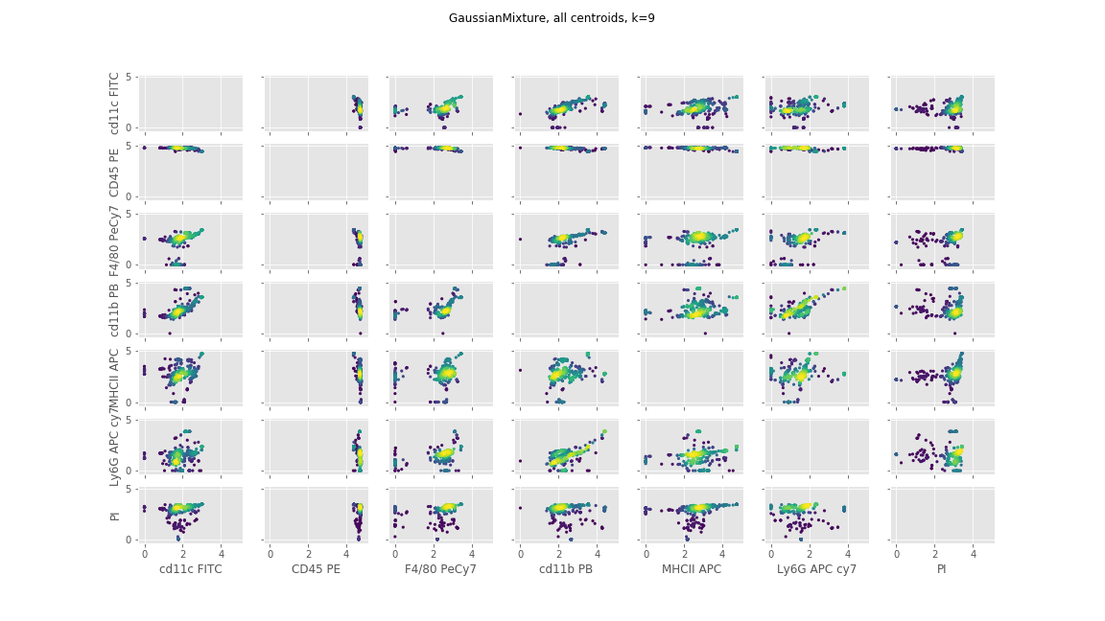
Centroid Plot (K1)

Slide 23
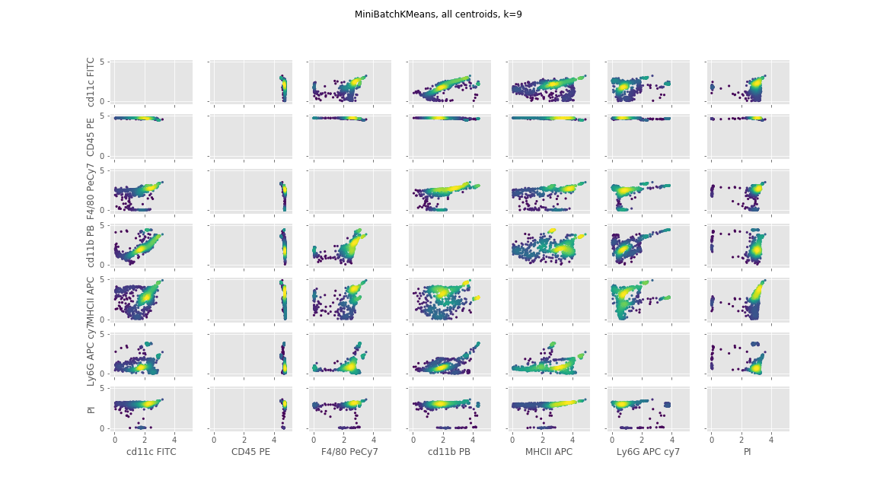
Centroid Plot (K1)

Slide 24
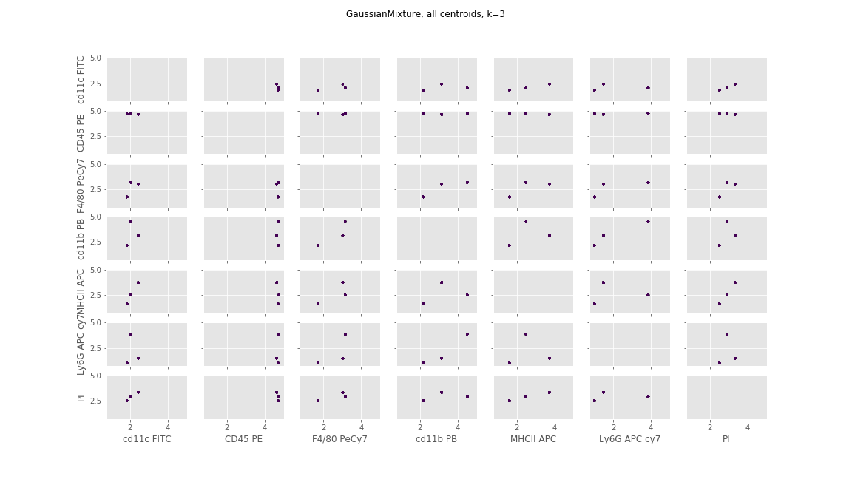
Centroid Plot (K2)

Slide 25
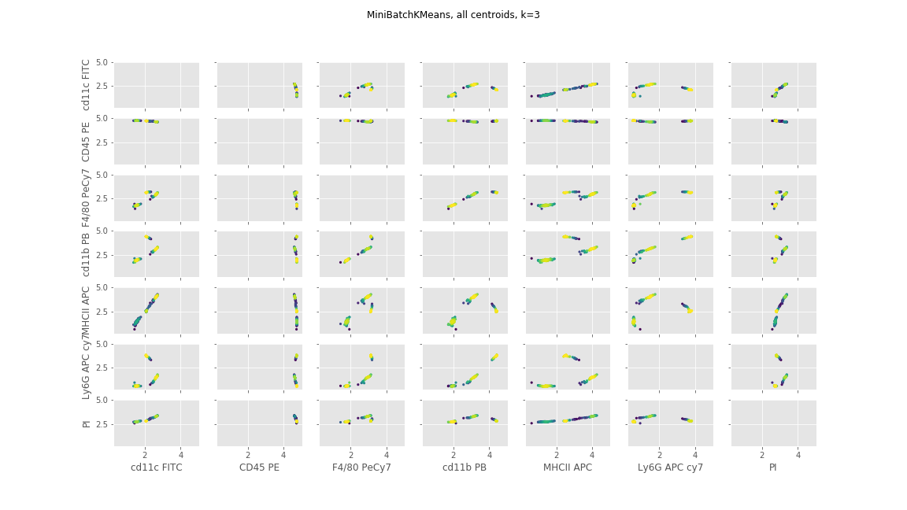
Centroid Plot (K2)

Slide 26
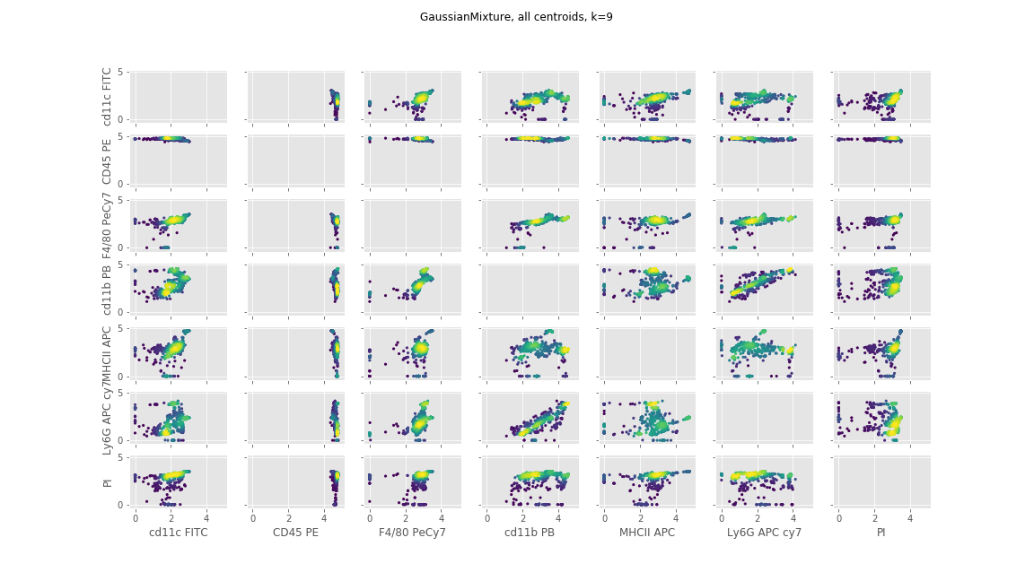
Centroid Plot (K2)

Slide 27
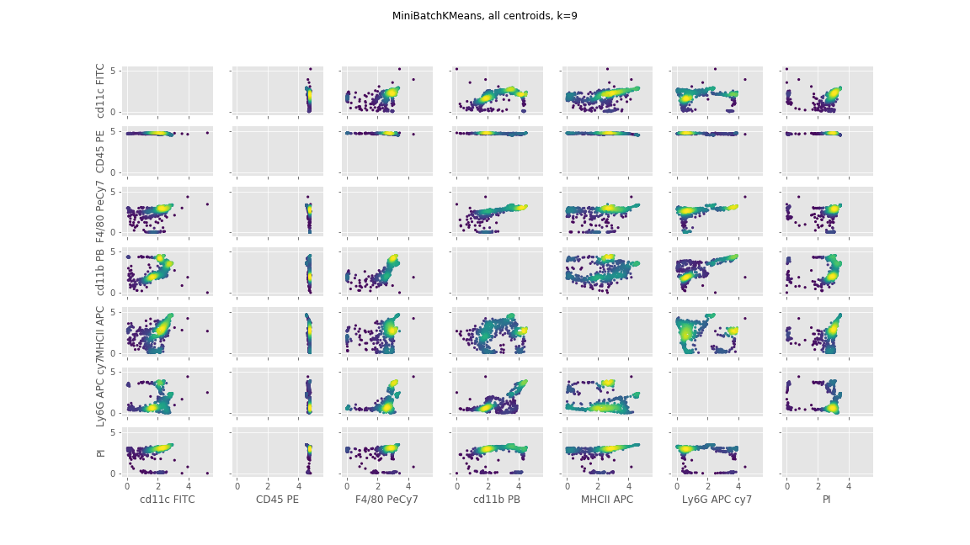
Centroid Plot (K2)

Slide 28
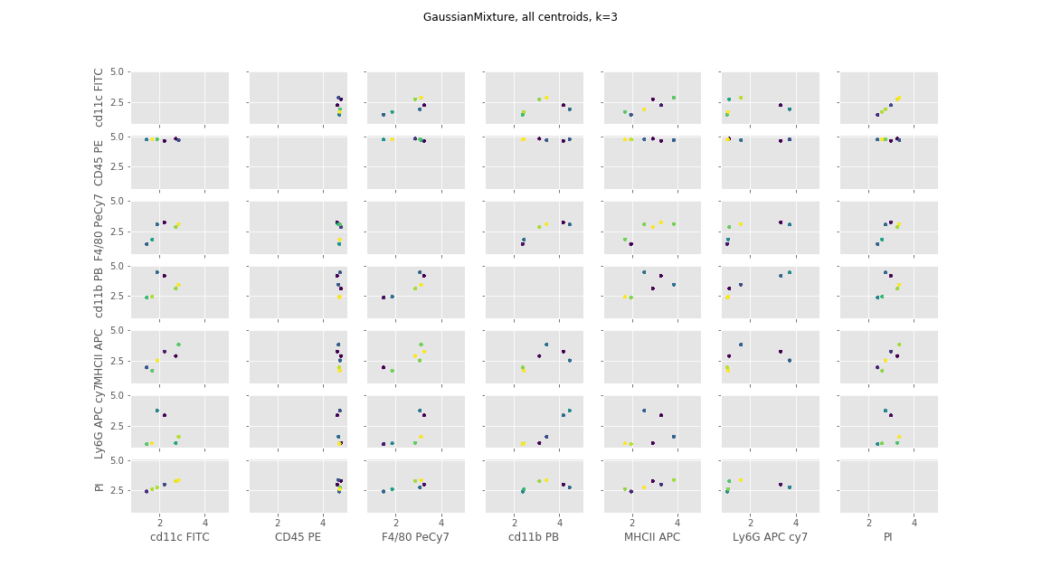
Centroid Plot (W1)

Slide 29
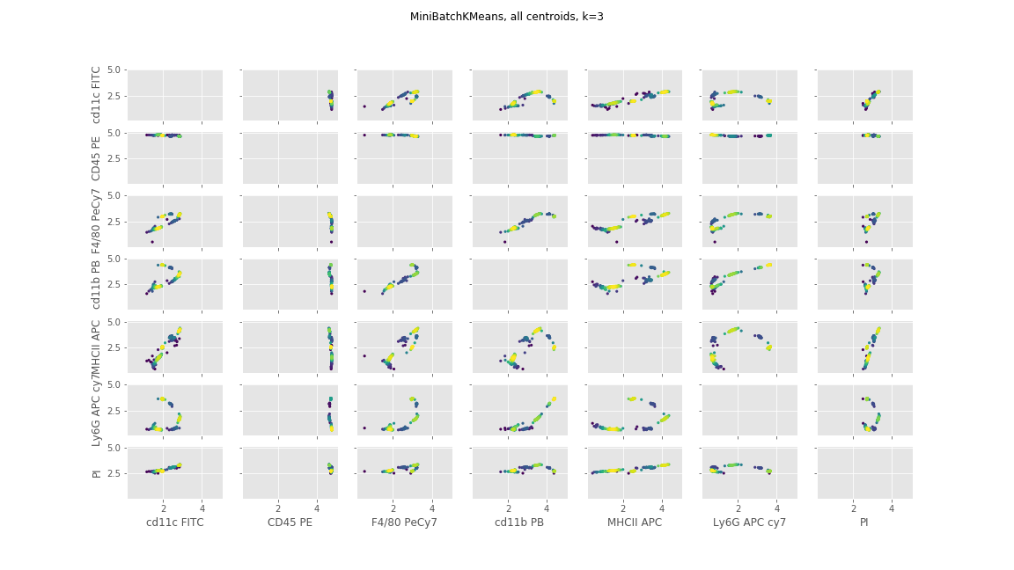
Centroid Plot (W1)

Slide 30
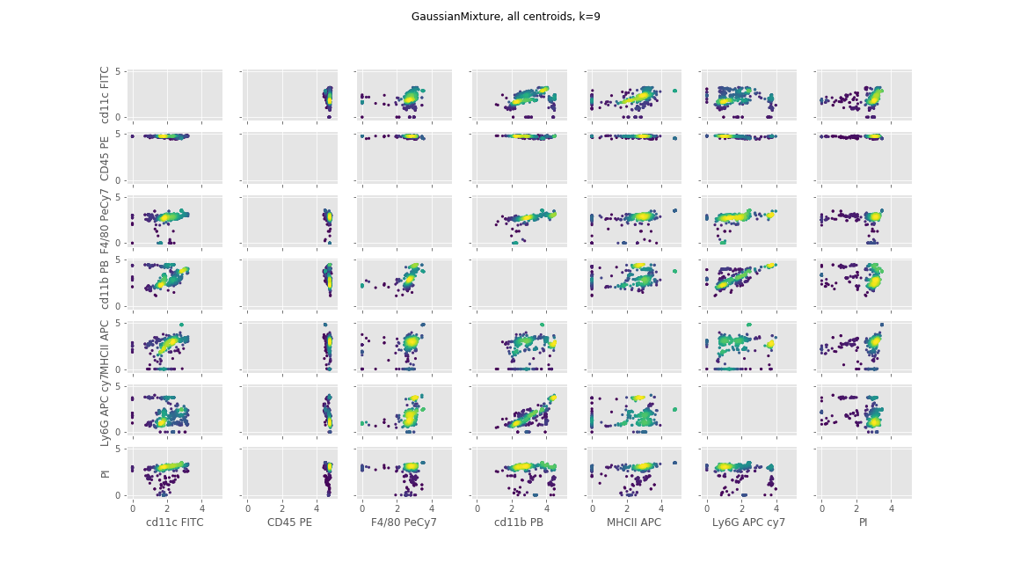
Centroid Plot (W1)

Slide 31
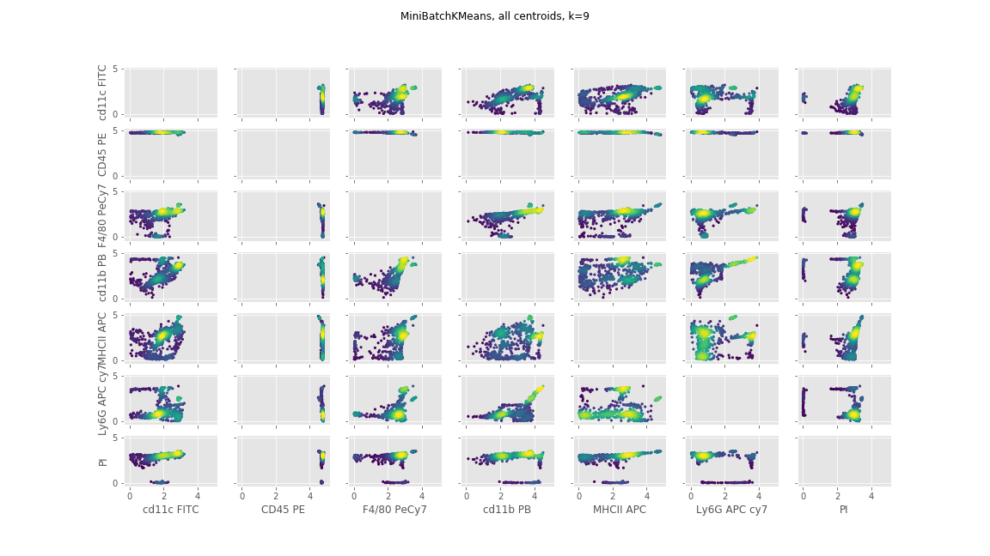
Centroid Plot (W1)

Slide 32
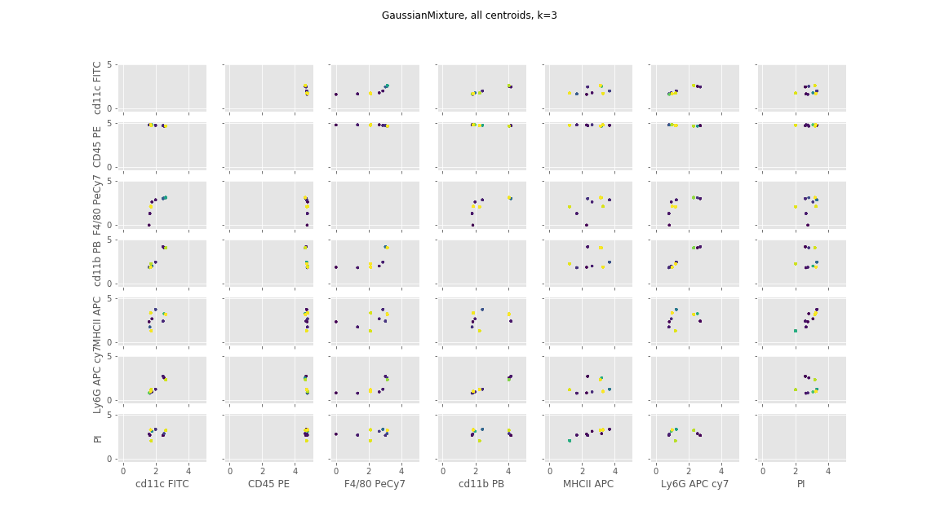
Centroid Plot (W2)

Slide 33
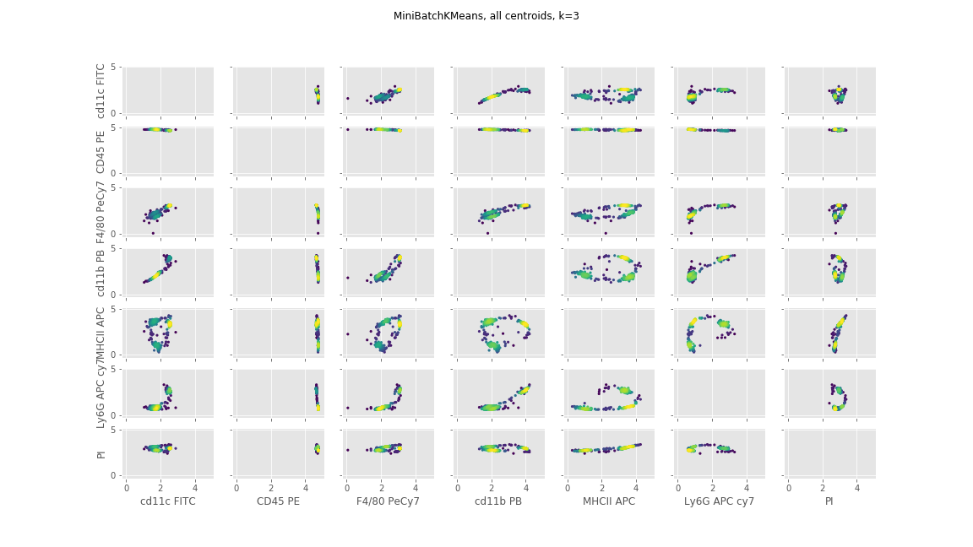
Centroid Plot (W2)

Slide 34
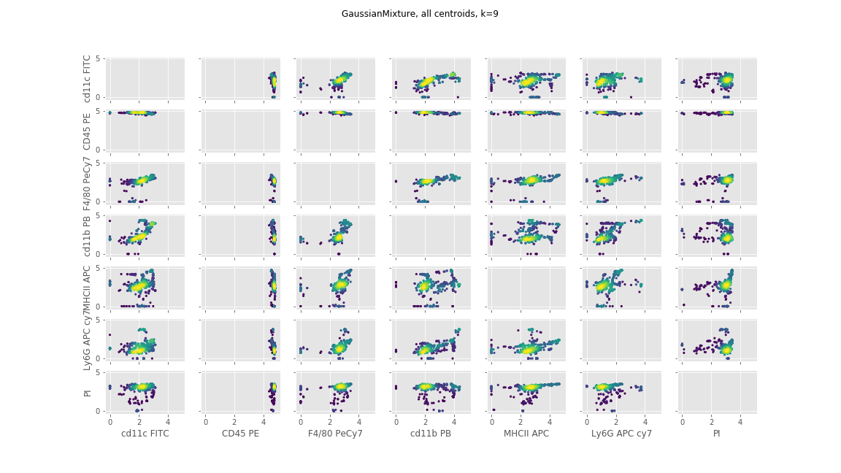
Centroid Plot (W2)

Slide 35
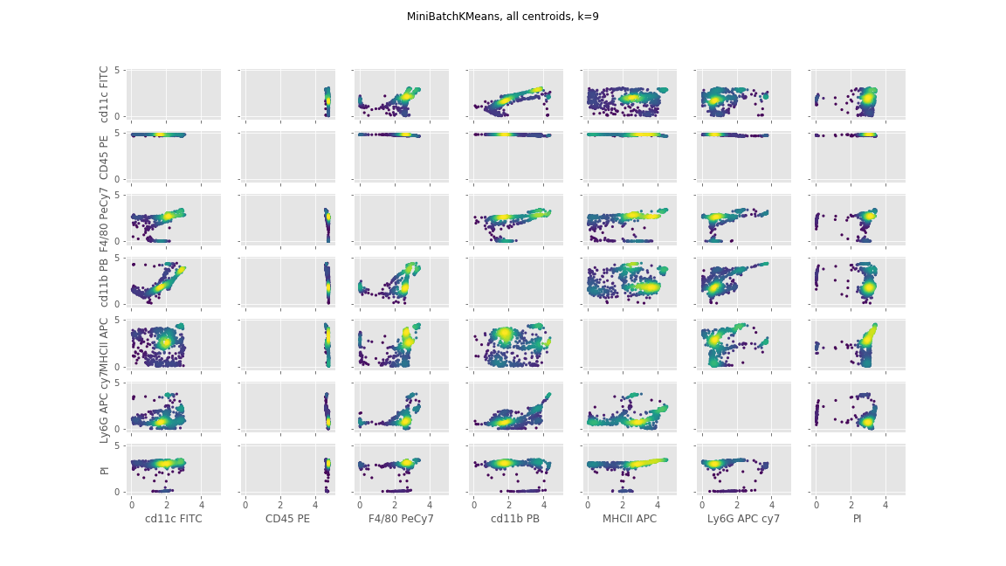
Centroid Plot (W2)

Slide 36
Conclusion
Gaussian Mixture appears to be more consistent than Kmeans
The clustering appears to be more consistent with fewer clusters
Gaussian Mixture with 3 clusters on K2 identifies the same exact centroids every time!

